Slide 1
Web Design with HTML and CSS
Day 10

Slide 2
Understanding Client/Server Architecture
Two-tier system
Client and server
Server or back end
Usually a database: client requests information
Client or front end
Responsible for user interface
Gathers information from user
Submits information to server
Receives, formats, presents results returned from the server

Slide 3
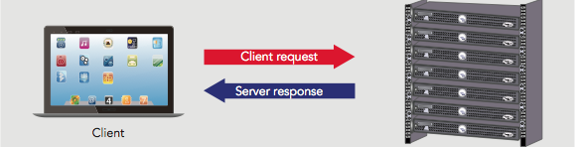
Understanding Client/Server Architecture
Figure 1-5 A two-tier client/server system
Web built on a two-tier client/server system
Requests and responses through which a web browser and web server communicate happen with HTTP

Slide 4
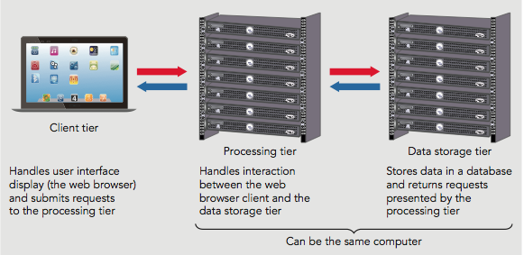
Understanding Client/Server Architecture
Figure 1-6 A three-tier client/server system
Three-tier, multitier, client/server system
Client tier
Processing tier
Data storage tier

Slide 5
JavaScript and Client-Side Scripting
Static web pages
Cannot change after browser renders them
HTML produced static documents
JavaScript
Allows web page authors to develop interactive web pages and sites
Client-side scripting language: runs on local browser
Scripting engine executes scripting language code
(The engine acts as an interpreter)
Scripting host
Web browser containing scripting engine

Slide 6
JavaScript and Client-Side Scripting
JavaScript history
First introduced in Netscape Navigator (LiveScript)
Navigator 2.0: name changed to JavaScript 1.0
Microsoft released Internet Explorer 4.0 version of JavaScript (Jscript)
ECMAScript
International, standardized version of JavaScript
Most recent version: edition ECMAScript7 (ECMAScript 2016)

Slide 7
JavaScript and Client-Side Scripting
Limitations of JavaScript
Cannot be used outside the web browser.
Cannot run system commands or execute programs on a client.
Mainly only can read and write cookies and a few other types of browser storage files.

Slide 8
Understanding Server-Side Scripting
Server-side scripting
Scripting language executed from a web server
Popular languages: PHP, ASP.NET, Python, Ruby
Can develop interactive web sites to communicate with a database
Server-side scripting language limitations
Cannot access or manipulate a web browser
Cannot run on a client tier

Slide 9
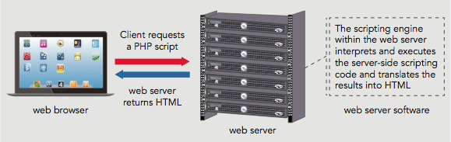
Understanding Server-Side Scripting
Figure 1-7 How a web server processes a server-side script

Slide 10
Should You Use Client-Side or Server-Side Scripting?
General rule of thumb
Allow client to handle user interface processing and light processing (data validation)
Have the web server perform intensive calculations and data storage
Important to perform as much processing as possible on the client

Slide 11
Adding JavaScript to Your Web Pages
Scripts
JavaScript programs contained within a web page’s HTML.
script element
Tells the browser that the scripting engine must interpret the commands it contains.
Has the <script> opening tag and </script> closing tag.
The individual lines of code, or statements, that make up the JavaScript program are contained within a single <script> element.
It is good practice in JavaScript programming to end each statement with a semicolon.

Slide 12
Add a script section to an HTML page
Go into the WA120_data_files folder.
Open the Chapter01 sub-folder.
Open the folder titled “chapter”.
Copy the files and folders contained within.
Navigate to where you normally save your project folders and create a new folder named “tinley_plants”.
Open this folder and paste all of the copied folders and files.

Slide 13
Add a script section to an HTML page
Open the file “plants.htm” in your Notepad ++ text editor.
Scroll down to the <article> element and click on the blank line provided between the <figcaption> tags.
Be sure to increase your indent beyond the indent for <figcaption>.
Add the opening <script> tag and press enter twice, then add the closing </script> tag.
Save plants.htm

Slide 14
Understanding JavaScript Objects
Object
Programming code and data
Treated as an individual unit or component
Procedures (or Functions)
Individual statements used in a computer program grouped into logical units
Used to perform specific tasks
Methods
Procedures associated with an object

Slide 15
Understanding JavaScript Objects
Property
Piece of data associated with an object
Assign value to a property using an equal sign
Argument
Information that must be provided to a method
Passing arguments
Providing an argument for a method

Slide 16
Using the write() Method
Document object
Represents content of a browser’s window.
Any text, graphics or other information displayed in a web page is part of the Document object.
Create new web page text with the write() method of the Document object
Method requires a text string as an argument.
Text string or literal string
Text contained within double or single quotation marks
Ex: document.write(“Plant choices”);

Slide 17
Case Sensitivity in JavaScript
JavaScript is case sensitive.
Within JavaScript code:
Object names must always be all lowercase.
Also, literal strings must be typed on a single line (wrapping within your editor is ok). If a line break is included while entering a text string, you will receive an error message.

Slide 18
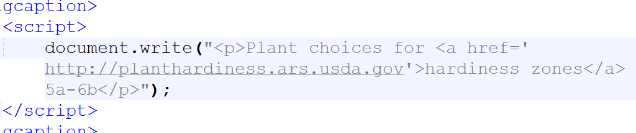
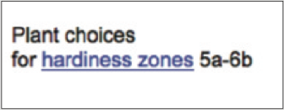
Using the write() Method (cont’d.)
Figure 1-8 Output of a script that uses the write() method of the Document object

Slide 19
Adding Comments to a JavaScript Program
Comments
Nonprinting lines placed in code containing various types of remarks
Line comment
Hides a single line of code
Add two slashes // before the comment text
Block comments
Hide multiple lines of code
Add /* before the first character included in the block and */ after the last character in the block

Slide 20
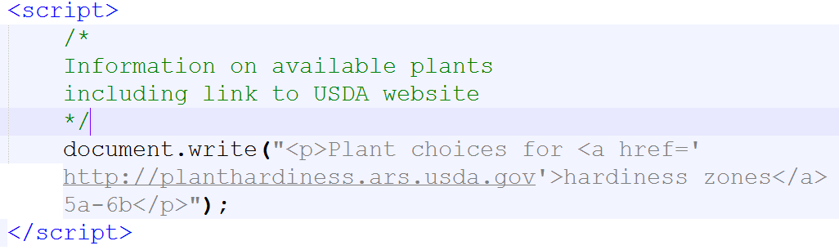
Add comments to the plants.htm document
Add the following block comment immediately after the opening <script> tag:

Slide 21
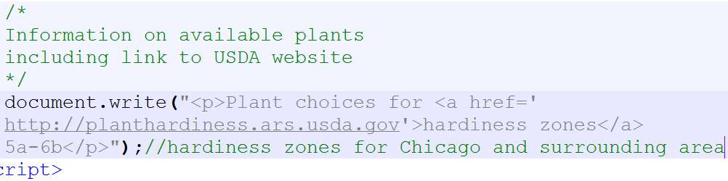
Add comments to the plants.htm document
Add the following line comment immediately after semicolon following the document.write( ) statement:

Slide 22
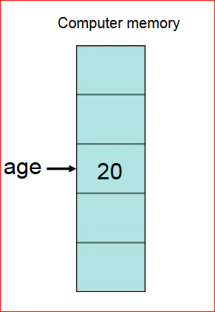
Using Variables
Variables
Values a program stores in computer memory
“Assigning” a value to a variable
Same as storing a value in a variable
http://slideplayer.com/slide/9350931/

Slide 23
Assigning Variable Names
Identifier
Name assigned to a variable
Rules and conventions
Must begin with an uppercase or lowercase ASCII letter, dollar sign ($), or underscore ( _ )
Can use numbers in an identifier: not as the first character
Cannot include spaces in an identifier
Cannot use reserved words for identifiers
Reserved words (keywords)
Special words: part of the JavaScript language syntax

Slide 24
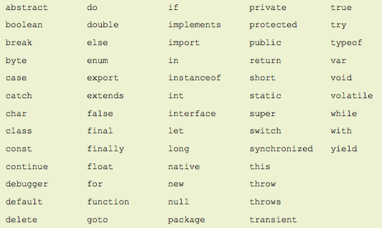
Assigning Variable Names (cont’d.)
Figure 1-10 JavaScript reserved words

Slide 25
Assigning Variable Names
var salesTotal;
var curOrder = 47.58;
salesTotal = curOrder;
No value assigned
Numeric value assigned
Assigns the value of curOrder to the salesTotal variable

Slide 26

Assigning Variable Names
Displaying variables: print a variable
Pass variable name to document.write() method
Do not enclose it in quotation marks
Code:
Result in browser:

Slide 27
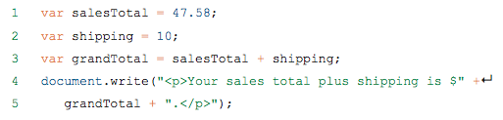
Assigning Variable Names
Displaying variables (cont’d.)
Use a plus sign to perform arithmetic operations involving variables containing numeric values
Code:
Result in browser:

Slide 28
Assigning Variable Names
Modifying variables
Change a variable’s value at any point in a script
Use a statement including the variable’s name
Followed by an equal sign
Followed by the value to assign to the variable

Slide 29
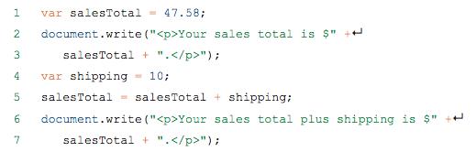

Assigning Variable Names
Code:
Result in browser:

Slide 30
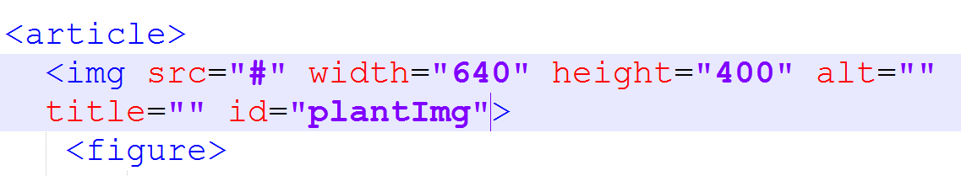
Add img element and variables to plants.htm
Within the <article> element, insert a new line just before the opening <figure> tag.
Enter the following code:

Slide 31
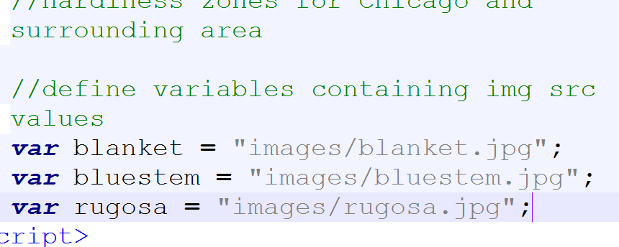
Add img element and variables to plants.htm
Within the existing script section, add the following comment and variables:

Slide 32
Building Expressions
Expression
Literal value or variable or a combination of literal values, variables, operators, and other expressions
Evaluated by JavaScript interpreter to produce a result
Operands
Variables and literals contained in an expression
Literal
Value such as a literal string or a number
Operators
Symbols used in expressions to manipulate operands

Slide 33
Understanding Events
Event
Specific circumstance monitored by JavaScript
Script can respond to an event in some way
Allows users to interact with web pages
Common events: actions users perform
Can also monitor events not resulting from user actions

Slide 34
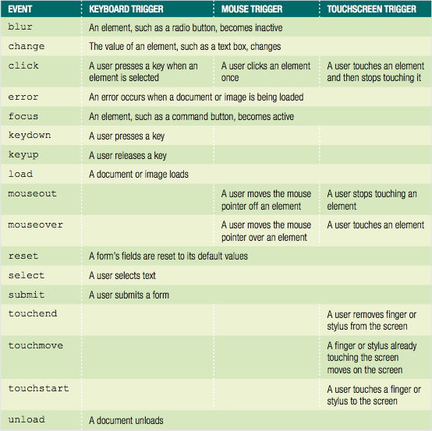
Understanding Events
Table 1-2 JavaScript events

Slide 35
Understanding Events
Working with elements and events
Events: associated with HTML elements
Event handler
Code that executes in response to a specific event on a specific element
JavaScript code for an event handler
Can be specified as attribute of element that initiates event

Slide 36
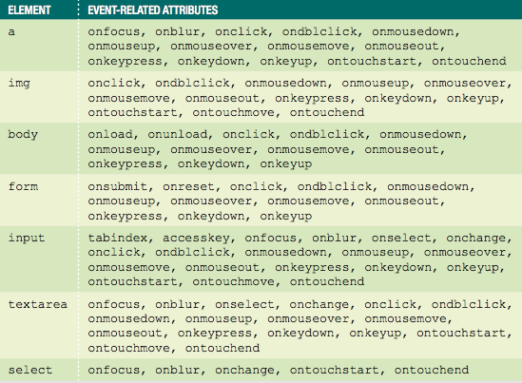
Understanding Events
Table 1-3 HTML elements and some of their associated events

Slide 37
Understanding Events
Referencing web page elements
Use the getElementById() method
Method of the Document object
Uses element's id value
Specific element properties
Appended to the element reference
Allows for the retrieval of information about an element or the ability to change the values assigned to its attributes

Slide 38
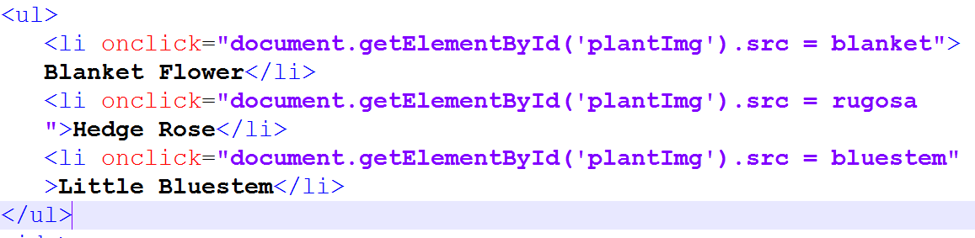
Add event handlers to plants.htm
Within the <aside> element, add the following event handler within the first <li> element:

Slide 39
Structuring JavaScript Code
Adding JavaScript code to a document
You must follow certain rules regarding placement and organization of that code.

Slide 40
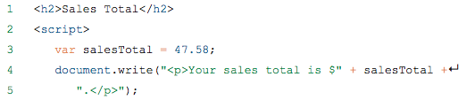
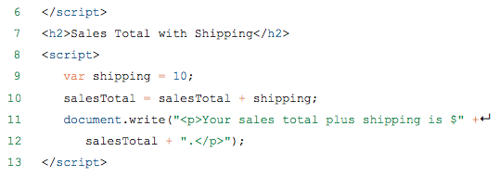
Including a script Element for Each Code Section
Can include as many script sections as desired
Must include a <script> element for each section
Example code below
See Figure 1-13 for results

Slide 41
Placing JavaScript in the Document Head or Document Body
<script> element placement varies
Can be placed in the document <head> or document <body>
Usually placed at end of body section before </body>
Statements rendered in the order in which they appear in the document (top-down).
Statements in head prevent rest of page from rendering. A large script can cause the browser to take a long time to render and display page content.

Slide 42
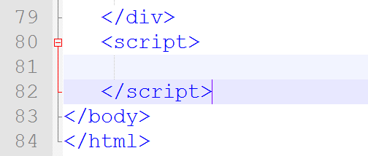
Move the Variable Declarations to a New Area in plants.htm
First, we will create a new script section immediately above our closing body tag:

Slide 43
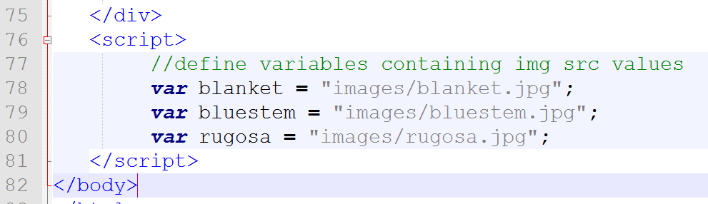
Move the Variable Declarations to a New Area in plants.htm
Next, cut the variable declaration statements along with the preceding comment from the script section in the <article> element.
Paste them into the script section that you just added at the end of the document body:

Slide 44
Creating a JavaScript Source File
External file containing JavaScript code
Usually designated by the .js file extension
Can technically have any extension
Contains only JavaScript statements
No script element and no HTML elements
Use the src attribute of the script element in your HTML which calls on the source file.
Advantages
Neater code; code sharing; ability to hide JavaScript code from incompatible browsers
Can use embedded JavaScript code and JavaScript source files combination

Slide 45
Using a JavaScript Source File
Once the source file is created (ex: “scripts.js”), it will need to be referenced in the HTML document.
This can technically be done anywhere, but common practice is to include it in its own folder, and then referenced in the <head> element of the HTML document.
Ex: <script src=“js/scripts.js”></script>

Slide 46
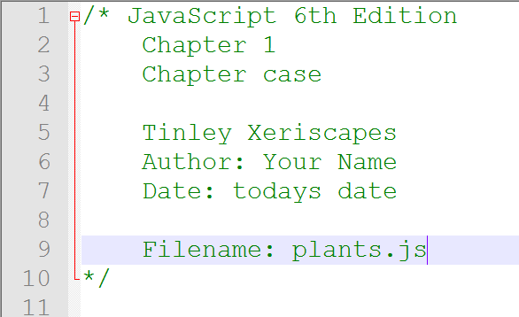
Create a Source File for Tinley Plant’s Website
Open a blank document in Notepad ++ and save the document.
Create a new folder named “js”
Inside the new folder, name the file “plants.js”
Enter the comments shown at the beginning of the “plants.js” document:

Slide 47
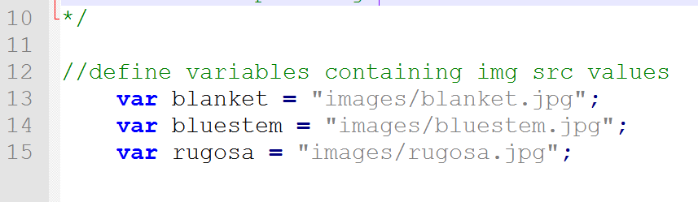
Create a Source File for Tinley Plant’s Website
Return to the “plants.htm” file and select the variable statements at the end of the document body (include the comment that precedes them also).
CUT the statements from “plants.htm”
Switch to “plants.js” and add a blank line after your comments, then PASTE the variable statements.

Slide 48
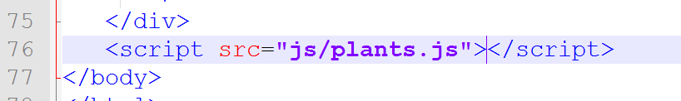
Create a Source File for Tinley Plant’s Website
Return to the “plants.htm” file and delete and blank spaces and line breaks seperating your opening and closing <script> tag.
Inside the opening <script> tag, add the following attribute to link to the JavaScript source file:
Save your files and then refresh the browser.
The web page should function as it did before.

Slide 49
Working with Libraries
Libraries: especially useful generic scripts used on different websites
Often developed by single programmer or team
Many available for free reuse
Common libraries
Node.js
React.js
Backbone.js
Modernizr
Libraries are downloaded as a .js file and then incorporated like you would any other source file: by creating a <script> element and using the src attribute to specify the filename.

Slide 50
Validating Web Pages
Validating parser
Checks for a well formed web page
Verifies document conforms to a specific DTD (document type definition)
Validation
Process of verifying a well-formed document and checking the elements in your document
Web development tools offer validation capabilities
Validating services found online
W3C Markup Validation Service:
http://validator.w3.org

Slide 51
Exercise
<html>
<head>
<title>Suffolk Sales Tax Calculator</title>
<style>
input {
background-color: #FFFF00;
}
</style>
<script>
var suffolkTax = 8.625; // as of November 2013
function calculateTax() {
var price = parseFloat(document.taxForm.itemPrice.value);
var tax = price/100 * suffolkTax;
document.taxForm.priceWithTax.value = (price + tax).toFixed(2);
}
</script>
</head>
<body>
<h1>Suffolk Sales Tax Calculator</h1>
<form name="taxForm">
Item price without tax:<br />
<input type="text" name="itemPrice" /><br />
<input type="button" value="calculate" onclick="calculateTax()" />
<br />
<input type="text" name="priceWithTax" />
</form>
</body>
</html>
Read through the source code to understand what it does and what the page will look like:

Slide 52
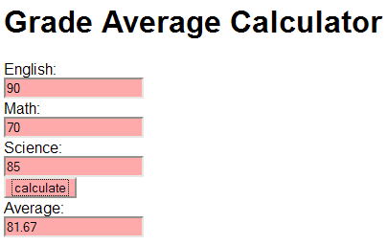
Exercise
Using the example from previous slide, create a page that contains a Grade Average calculator.
Create a “/scripts” folder and a separate JavaScript file, for example ga_script.js. Place your JavaScript code inside that file. Reference the JavaScript file from your HTML page, e.g.:
<script src=”scripts/ga_script.js”></script>

